Slide 1
CMPM17: Final Project
By Liam Youm & Kevin Nguyen
Team Name: Thing 1 & Thing 2

Slide 2
Agenda
Reminders
Problem/Goal
Model Description
Dataset Processing & Analysis
Model Results
Reflection & Challenges
Take notes on questions you want to ask by the end of the presentation!
This format is a bit on the nose…

Slide 3


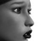



Problem/Goal
Create a model to distinguish between 6 facial expressions:
Angry
Fear
Happy
Neutral
Sad
Surprise

Slide 4
Model Description

Slide 5
Model Description
CNN architecture
4 convolutional layers
3 linear layers
3x3 kernels & 1 padding on all convolutional layers
32 batch size
30 epochs
Batch normalization after every layer
ReLU activation function & Adam optimizer

Slide 6
Model Refinements/Iterations
Adding layers 3 and 4 (64 and 128 filters respectively)
Grants complexity
10 -> 30 epochs
Enough epochs for noticeable improvements; flattens afterwards

Slide 7
Dataset Processing & Analysis
Notes:
KEVIN
Now we head to the dataset processing & analysis portion

Slide 8


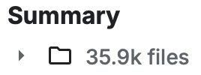
About the Dataset (FER-2013)
Pretty organized already:
48x48 grayscale faces; already centered
Training Set: 29,000 images
Test Set: 3,600 images
Notes:
KEVIN
So, firstly looking into the dataset itself, it’s got quite a lot of image, about 30,000 48x48 grayscale faces that are already centered for us
It was already pretty clean when we first got it, so ultimately we didn’t do a bunch of things

Slide 9
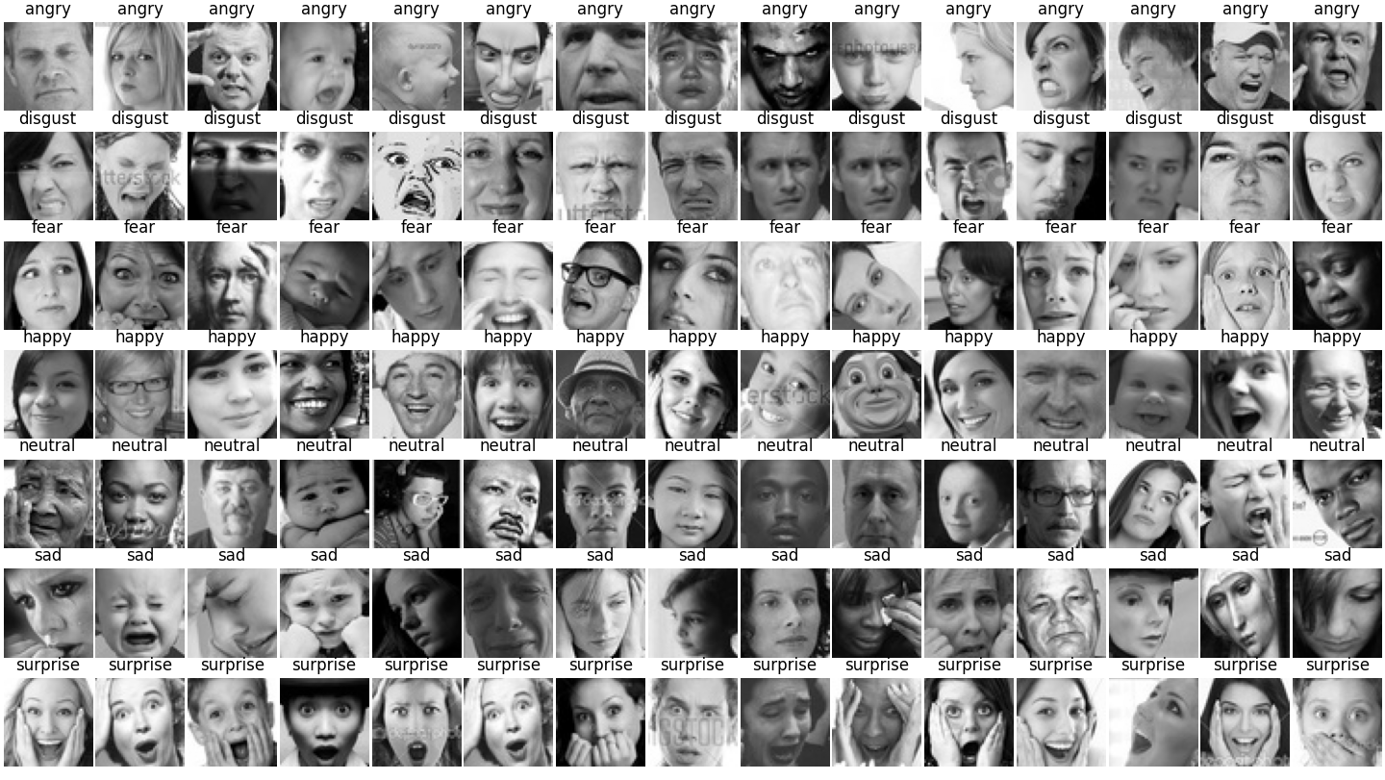
We did a few things after viewing…
Notes:
KEVIN
So then we went in for qualitative analysis, and here’s our picture of us printing 100 images, 10 for each class, and we found a few things when viewing the dataset that we decided to change

Slide 10


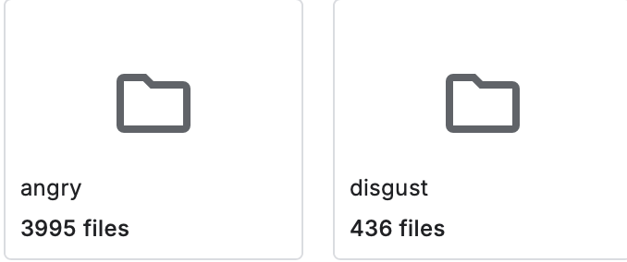
1. Disgust & Anger Folders
Disgust folder face that looks angry…
We merged them together!
Why:
Faces are similar
Disgust folder has little samples
CNNs online also struggled with this problem!
…and an angry folder face that looks disgusted???
train folder ->
Notes:
KEVIN
First of all, we decided to merge the disgust and anger folders together
There were a couple of reasons for this. Firstly, the faces looked similar. You can see to the right that there are disgust folder faces that look angry, and angry folder faces that look disgusted
Secondly, the disgust folder had like no samples. The other folders had 4000-5000 typically, but the disgust training folder had less than 500 images. That’s just way too low for our model to predict disgusted faces
Lastly, I remember seeing online of other facial recognition models being used for YouTube videos, and I noticed that those models would often mix angry and disgusted faces together. So, after a bit of thinking, we decided to merge the folders together to make things easier on the model

Slide 11
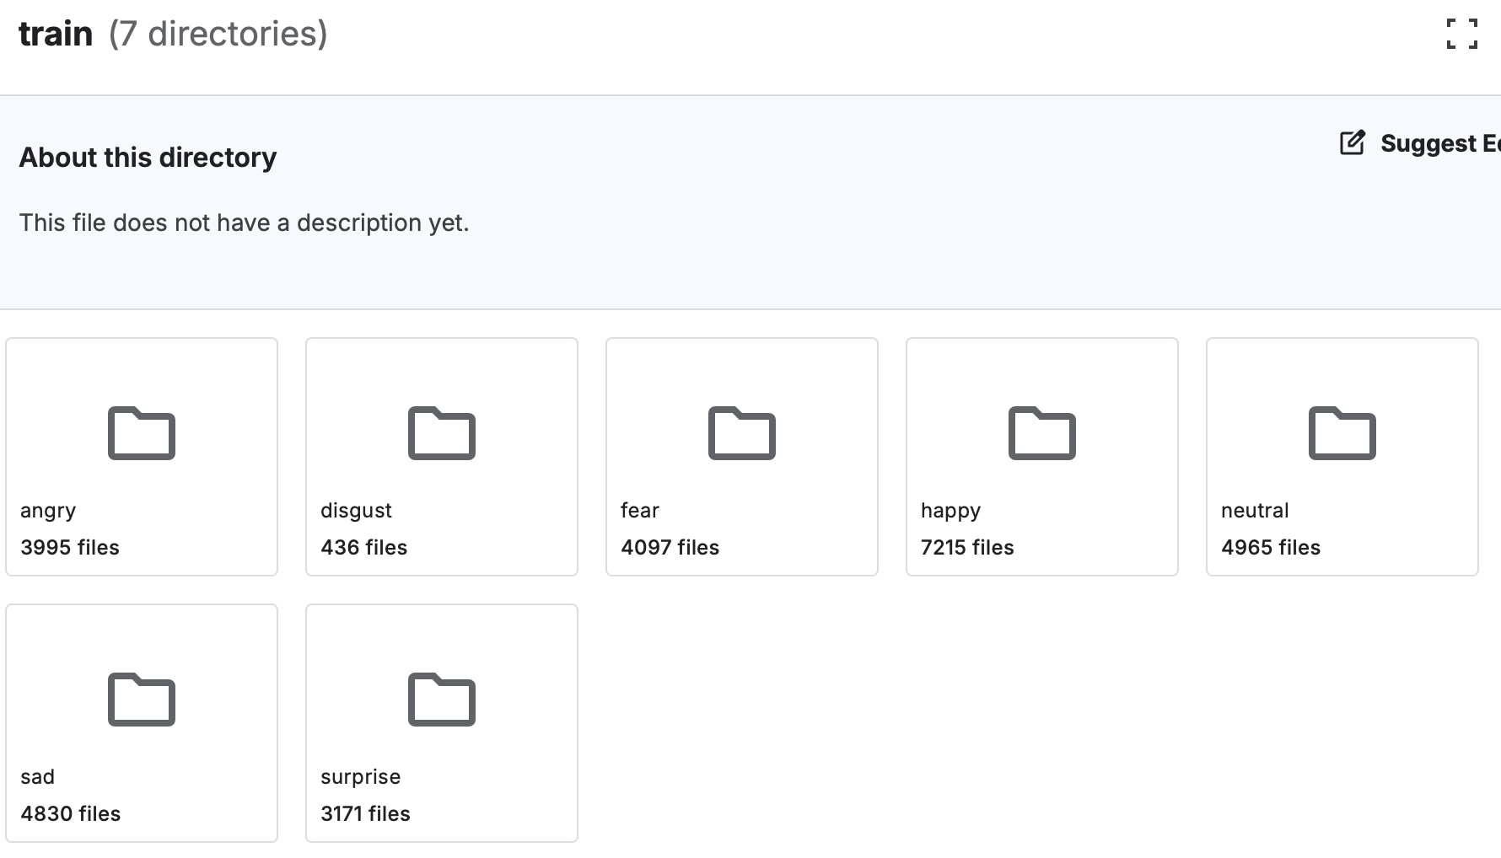
2. Happy Folder
We cut about 2000-3000 happy images
Why:
Too many images
May cause bias or make model worse if not cut
Balances training
Notes:
KEVIN
The second thing we did was that we cut 2000 to 3000 images from the happy folder
If you look at the image of the train directory, there’s the classes with about 4000 or 5000, but then the happy folder has 7000. That’s way too much
We don’t want to make our model have any biases toward happy expressions, and it might make the model guess happy expressions more often since it would be exposed to those more often if they weren’t cut
We believe that, by cutting the images out, it should ultimately make our model more balanced and reliable

Slide 12
3. Image Channels
We used v2.Grayscale(1) on our tensors, even though it’s already grayscale
Why:
Tensor shape had 3 channels, but grayscale should only 1
Properly makes them 1
Notes:
KEVIN
Then, lastly, for a quick thing to clean up the data, we used the v2.Grayscale transformation on our tensors.
You might be thinking, if grayscale images are 1 channel, why would we need to grayscale it again? Well, it’s because, when putting the image into our code, the shape of the tensor is actually 3 channels. You can see in the error message at the very end that it says the tensor shape has 3 channels.
So, we use v2.Grayscale to properly make them into 1 layer and to prevent any further issues

Slide 13
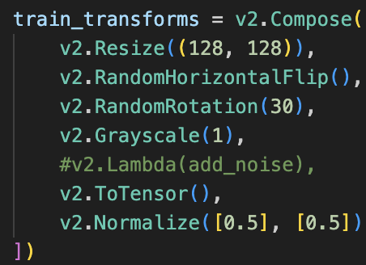
Data Augmentations Used
Mainly just rotations & flips
Facial expressions require a lot of information to predict, even from humans, so not many augmentations are needed!
Notes:
KEVIN
Speaking of data augmentations, here are the ones we used, and ultimately they aren’t very significant. They’re just mainly rotations and flips
The reason our augmentations aren’t very significant is because we believed that facial recognition requires quite a bit of information to predict, even from humans. We didn’t think it would be realistic of our model to predict images that were severely altered. For example, cropping the image would likely remove key features of the face to identify the facial expression, and color changing wouldn’t matter since they’ll all be grayscale.

Slide 14
Model Results

Slide 15
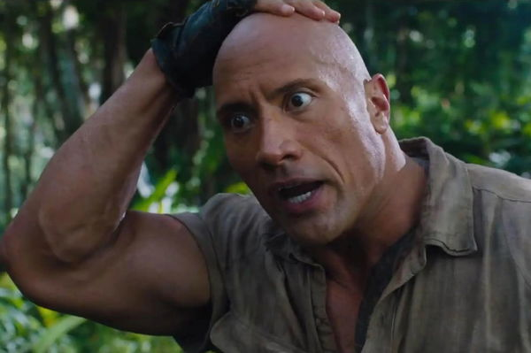
The Numbers
Goals
Bare min accuracy: 25%
Initial target accuracy: 40%
Final target accuracy: 60%
Test accuracy: ~60%
Average train accuracy: 66.9%
Average Loss: 1.09
(subtle foreshadowing)

Slide 16
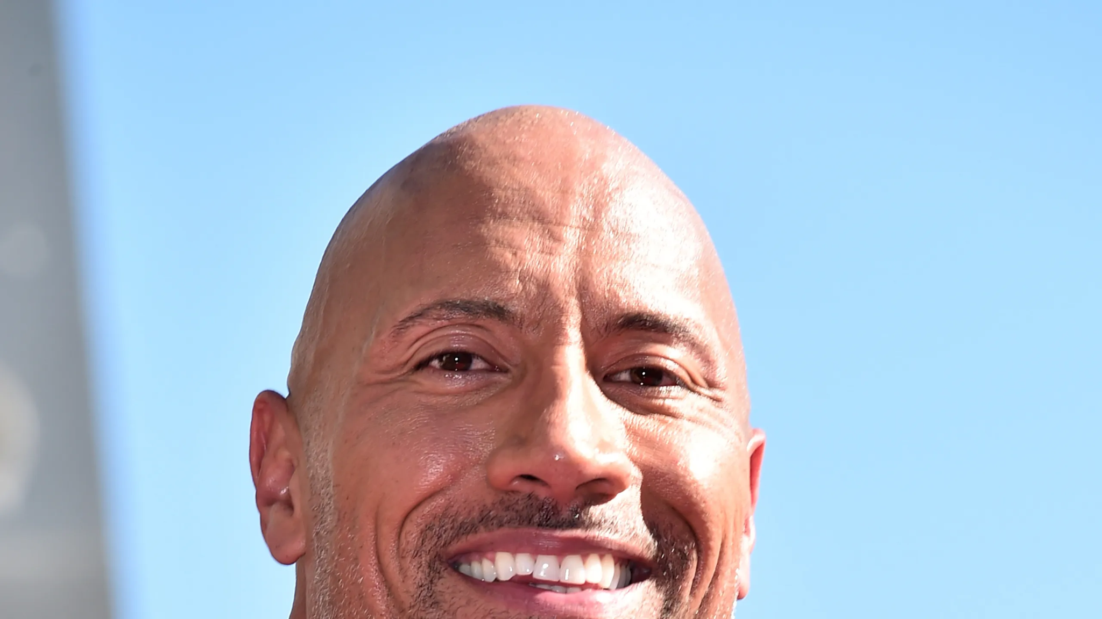
Thoughts
Very good! Reached & surpassed expectations (60% target accuracy)
Notes: Possible overfitting, unstable learning
(subtle foreshadowing)

Slide 17
Demo Time!
Notes:
After showing our results, we’ll now have time for our demo of our model

Slide 18
Reflection
Notes:
KEVIN
Now, we can talk about the reflection

Slide 19
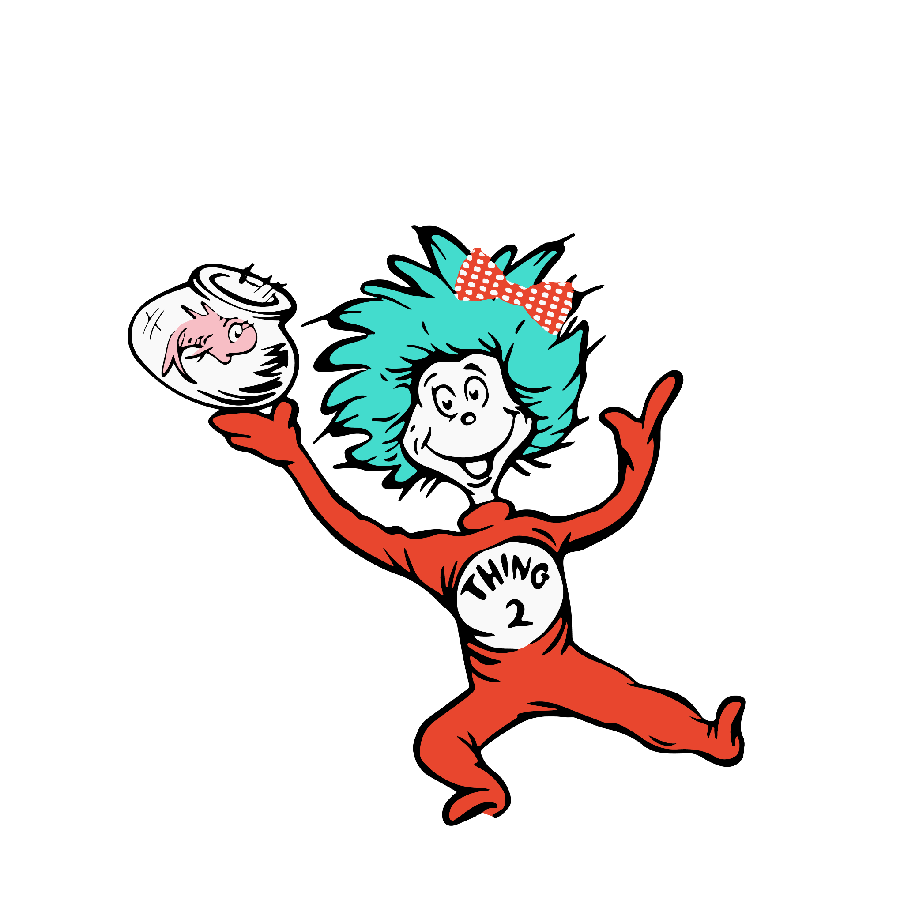
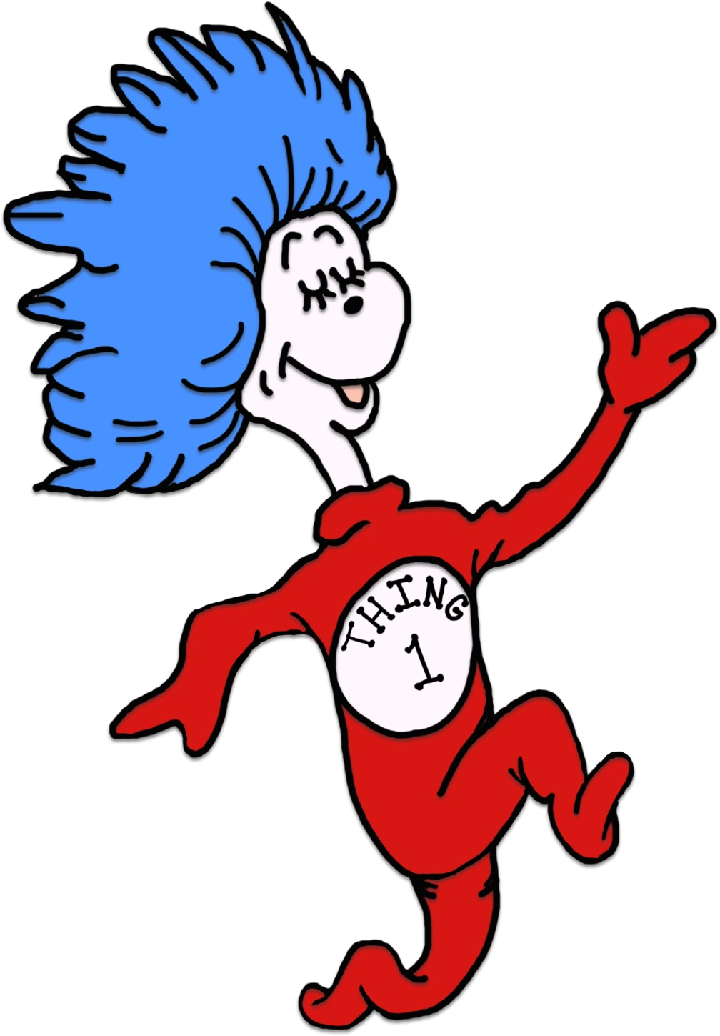


What Went Well
Work ethic, punctuality, communication & feedback
Good system!
Liam focused more often on advanced coding
Kevin focused more often on code structure & documents
Notes:
KEVIN
Generally, the project went pretty well. There was good work ethic, we could finish our work on time and sometimes early, and there was pretty good communication and feedback
Since our academic knowledge varied, there was also this system we made where I (Kevin) would mainly work on the foundational code and the documents, while Liam worked on the more advanced portions of the code. Of course, we stil both did coding and document every week, and most weeks had us doing an even distribution of the two, but this was often the pattern when things got complex and we utilized more advanced ideas

Slide 20
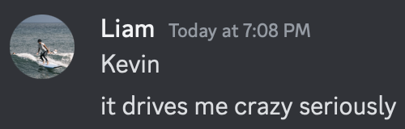
Challenges - What We Encountered
Rocky start - uneven work distribution
Kubernetes…
Notes:
KEVIN
Of the challenges we encountered, not a lot. Mainly, it was that the work might have not been distributed equally at times, especially at the start. I (Kevin) didn’t do as much as I should’ve in milestone 0, but afterwards I was able to pick up the pace
Then there was also Kubernetes, which wouldn’t comply with us sometimes. Fortunately for me, I didn’t have to deal with it often since that wasn’t my job for most of it. Liam though… he didn’t have the best time trying to get it to work

Slide 21
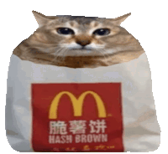
Challenges - How We Addressed Them
Feedback & self-reflection
Office hours, Discord server
Getting gooder
Notes:
KEVIN
And so, we addressed these challenges through the self-reflection prelabs and giving each other feedback
For technical issues, there would be office hours and the Discord server we’d consult which helped
And in general, we kinda just solved some of the problems ourselves. We just had to get gooder

Slide 22
What We Would’ve Done Differently
Still try to even out work distribution
Keep up work ethic
Otherwise, not too much!
Notes:
KEVIN
For what we would’ve done differently, it probably would have been a good thing for the both of us to have evened out the work distribution. It might’ve been healthier for the both of us and given each other an even amount of experience
Also, it would have been nicer to possibly have a better work ethic than what we already did. Our meetings were on Sunday which would be the day the milestone was due, so perhaps if we completed more work before then and then our meeting was about refining our work, it might’ve made for an easier time
Otherwise, it went pretty well, so there isn’t a bunch to change

Slide 23
RECAP
CNN to predict facial expressions
Added layers & epochs to improve model
Evened out classes for better training
Model reached desired results
Overall experience went well save a few difficulties
Notes:
KEVIN
And so, to recap, we created a CNN that predicted facial expressions
[model iterations]
Then we cleaned up the data and evened out the class sizes to make for better training
[model results]
And overall, the final went pretty smoothly, save a few issues here and there

Slide 24
Thanks for listening!
Questions, comments, concerns?

